Slide 1

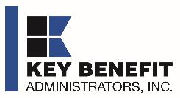
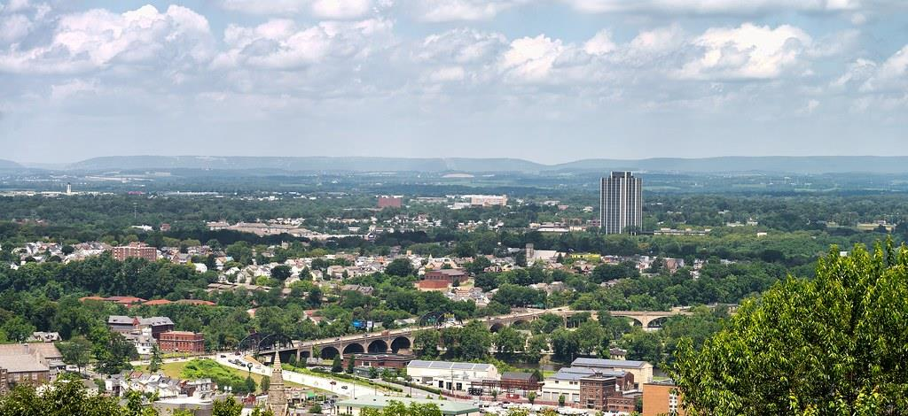
EPO vs. PPO NETWORK DECISION
September 25, 2024

Slide 2

Deciding Between EPO and PPO Plans
Deciding between a PPO and EPO plan is an important strategic decision for SLUHN.
Key Benefits investigates every potential DTE partner and will not administer a DTE narrow network unless we are confident the DTE narrow network will sell well.
Key Benefit Administrator recommends a narrow network plan for two key reasons:
1
2
4X MORE PROFITABLE
A narrow network plan creates powerful patient steerage, generating 440% more revenue and profitability for SLUHN than a similar-sized PPO plan.
Framed differently, a SLUHN PPO network would need to be 4x larger than a narrow network plan to produce the same revenue and profit growth.
SLUHN HAS NEEDED MARKET, QUALITY AND ACCESS
KBA estimates that only 13% of health systems with 200+ beds in a state have the needed access and brand quality to support a DTE EPO plan.
SLUHN is in the 94% percentile for market strength, access and brand quality supporting a DTE. KBA is very confident a SLUHN DTE plan will be successful.

Slide 3

Direct-to-Employer Strategy: Only Available to Premier Health Systems
STRONG Brand Quality
EXTENSIVE Patient Access
AFFORDABLE Value Pricing
EXCELENT Care Quality

Slide 4


Direct-to-Employer Strategy: Only Available to Premier Health Systems
Excellent
Fair
Poor
Poor
Fair
Excellent
Access
Quality
Cost

Slide 5
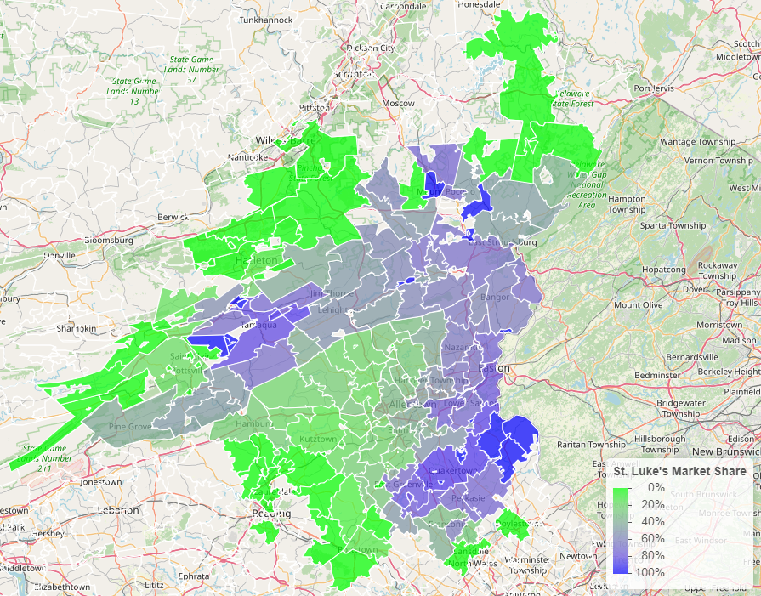
SLUHN Advantage: Strong Brand Quality
Comparison of Medicare payment market share by zip code: St Luke’s vs Lehigh Valley Health Network

Slide 6
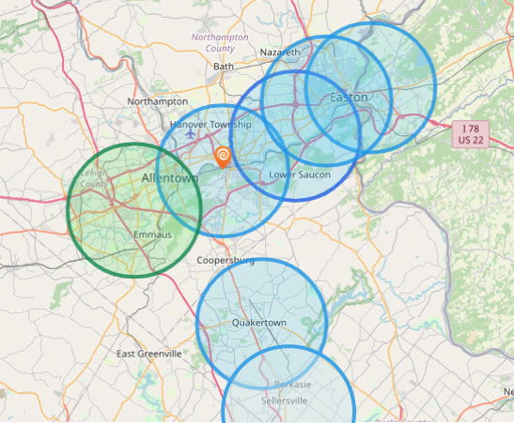
SLUHN Advantage: Best-in-Area Patient Access
Hospital | Population Within 5 Miles
St Luke's Hospital - Anderson Campus | 142,000
St Lukes Upper Bucks Campus | 46,000
St Luke's Hospital Bethlehem | 255,000
St Luke's Warren Hospital | 118,000
St Luke's Hospital - Easton Campus | 141,000
St. Luke’s Hospital Monroe County | 48,667
St. Luke’s Hospital Carbon County | 26,628
Grand View Hospital | 70,739
Hospital | Population Within 5 Miles
Lehigh Valley Hospital Cedar Crest | 227,393

Slide 7

SLUHN Advantage: Leading Care Quality
Patient HCAHPS Recommendation Rate Percentile | CMS Quality Stars Percentile | Mortality Average Percentile | Readmission Percentile
73% | 99% | 86% | 63%
53% | 58% | 72% | 63%
Source: CMS measurements of HCAHPS patient experience (percent who would strongly recommend), CMS Stars, high-variation mortality rates and high-variation readmission rates all shown as percentiles compared to all hospitals nationally, with the 99th percentile being the best.

Slide 8
SLUHN Advantage: Care at Value Pricing
Hospital | Rand Outpatient Services Percent of Medicare | Rand Inpatient Services Percent of Medicare
St Luke's Hospital - Anderson Campus | 290% | 280%
St Lukes Upper Bucks Campus | 292%
St Luke's Hospital Bethlehem | 287% | 214%
St Luke's Warren Hospital | 251%
St Luke's Hospital - Easton Campus | 212%
St Luke’s Hospital - Monroe County | 251% | 219%
Grand View Hospital | 179% | 197%
Lehigh Valley Hospital Cedar Crest | 315% | 249%
Source: RAND round 5 hospital cost data: https://www.rand.org/pubs/research_reports/RRA1144-2.html

Slide 9
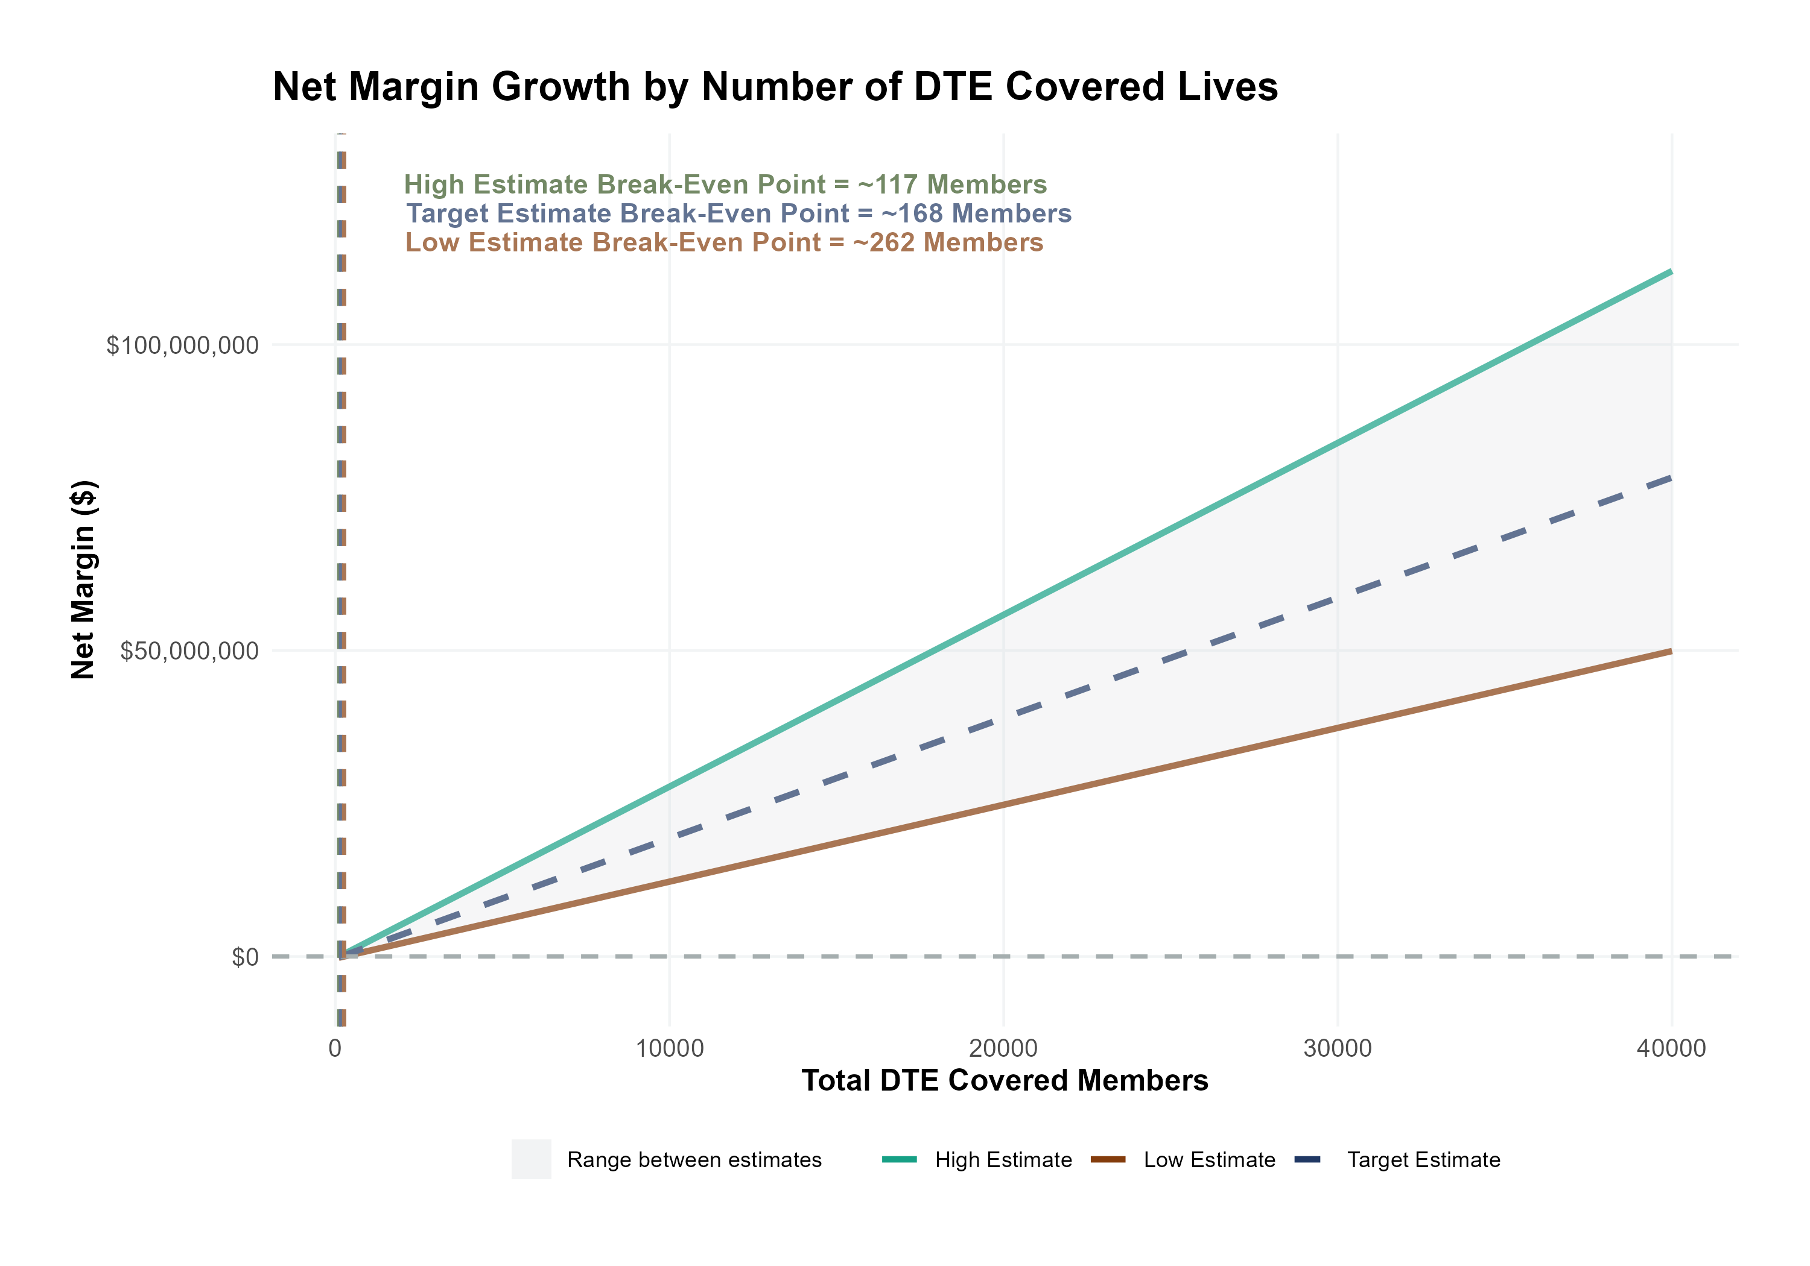
EPO Plan: Breakeven With 168 Members
Patient Steerage Assumptions
KBA currently estimates that Saint Luke's University Health Network has 32% inpatient market share, and 17% outpatient market compared to hospitals/clinics in the Luzerne, Carbon, Schuylkill, Lehigh, Northampton, Warren, Hunterdon, and Bucks Counties. Based on other KBA DTE networks, we expect steerage to be:
SINGLE-YEAR PROJECTION
Low
Target
High
70%
77%
85%
Commercial Margin Assumptions
KBA estimates DTE margins to be similar to the margin of other commercial plans (prices are lower but billing costs and self-payments are higher). We model DTE commercial margin as on target, below and above other commercial plans.
Low
Target
High
5% Below
Same
5% Above

Slide 10
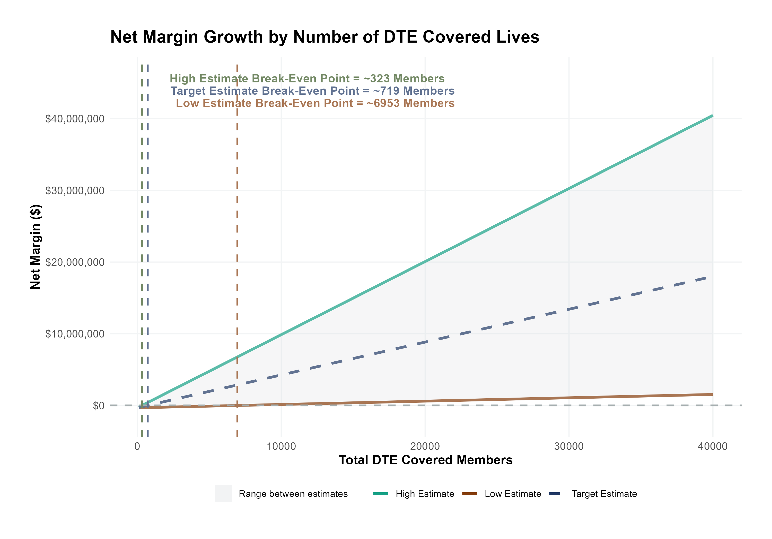
PPO Plan: Breakeven With 719 Members
Patient Steerage Assumptions
KBA currently estimates that Saint Luke's University Health Network has 32% inpatient market share, and 17% outpatient market compared to hospitals/clinics in the Luzerne, Carbon, Schuylkill, Lehigh, Northampton, Warren, Hunterdon, and Bucks Counties. Based on other KBA DTE networks, we expect steerage to be (inpatient/outpatient):
SINGLE-YEAR PROJECTION
Low
Target
High
37%/25%
42%/32%
50%/40%
Commercial Margin Assumptions
KBA estimates DTE margins to be similar to the margin of other commercial plans (prices are lower but billing costs and self-payments are higher). We model DTE commercial margin as on target, below and above other commercial plans.
Low
Target
High
5% Below
Same
5% Above

Slide 11
EPO Plan: $9.5M with First 5K Members
Pre-DTE Cohort of 5,000 Members | Inpatient | Outpatient | Professional | Total
Revenue† | $ 5,813,802 | $ 5,356,579 | $ 2,500,978 | $ 13,671,359
Net Income‡ | $ 1,505,901 | $ 1,387,470 | $ 647,807.7 | $ 3,541,179
† Assuming proportional revenues from market shares of 32% (inpatient) and 17% (outpatient)
‡ Conservatively assuming a commercial margin of 25.9% (70% of the observed commercial margin)
With DTE | Inpatient | Outpatient | Professional | Total
Revenue⁰ | $ 14,010,150 | $ 25,471,600 | $ 11,892,650 | $ 51,374,400
Net Income* | $ 3,628,933 | $ 6,597,698 | $ 3,080,455 | $ 13,307,085
⁰ Assuming 77% market steerage based on KBA narrow network DTE experience
* Conservatively assuming a commercial margin of 25.9%, with a 10 percentage-point reduction to reflect competitive-edge rates and a 10 percentage-point increase to reflect lower billing costs and better patient-responsibility collections because of the plan patient card.
Total Increase in Net Income | $ 9,765,906
Network Access Fee (Revenue) of $1 PMPM | $ 60,000
Total Profit Growth | $ 9,825,906
Minus Implementation Fee (One-Time) | -$ 150,000
Minus Sales and Marketing (Annual – Ongoing) | -$ 180,000
Total | $ 9,495,906

Slide 12
EPO Plan: $1.96M with First 5K Members
Pre-DTE Cohort of 5,000 Members | Inpatient | Outpatient | Professional | Total
Revenue† | $ 5,822,400 | $ 5,954,400 | $ 2,780,100 | $ 14,556,900
Net Income‡ | $ 1,508,128 | $ 1,542,319 | $ 720,106.3 | $ 3,770,553
† Assuming proportional revenues from market shares of 32% (inpatient) and 17% (outpatient)
‡ Conservatively assuming a commercial margin of 25.9% (70% of the estimated commercial margin)
With DTE | Inpatient | Outpatient | Professional | Total
Revenue⁰ | $ 7,641,900 | $ 10,585,600 | $ 4,942,400 | $ 23,169,900
Net Income* | $ 1,979,418 | $ 2,741,900 | $ 1,280,189 | $ 6,001,507
⁰ Assuming 42% market steerage based on KBA narrow network DTE experience
* Conservatively assuming a commercial margin of 25.9%, with a 10 percentage-point reduction to reflect competitive-edge rates and a 10 percentage-point increase to reflect lower billing costs and better patient-responsibility collections because of the plan patient card.
Total Increase in Net Income | $ 2,230,954
Network Access Fee (Revenue) of $1 PMPM | $ 60,000
Total Profit Growth | $ 2,290,954
Minus Implementation Fee (One-Time) | -$ 150,000
Minus Sales and Marketing (Annual – Ongoing) | -$ 180,000
Total | $ 1,960,954

Slide 13
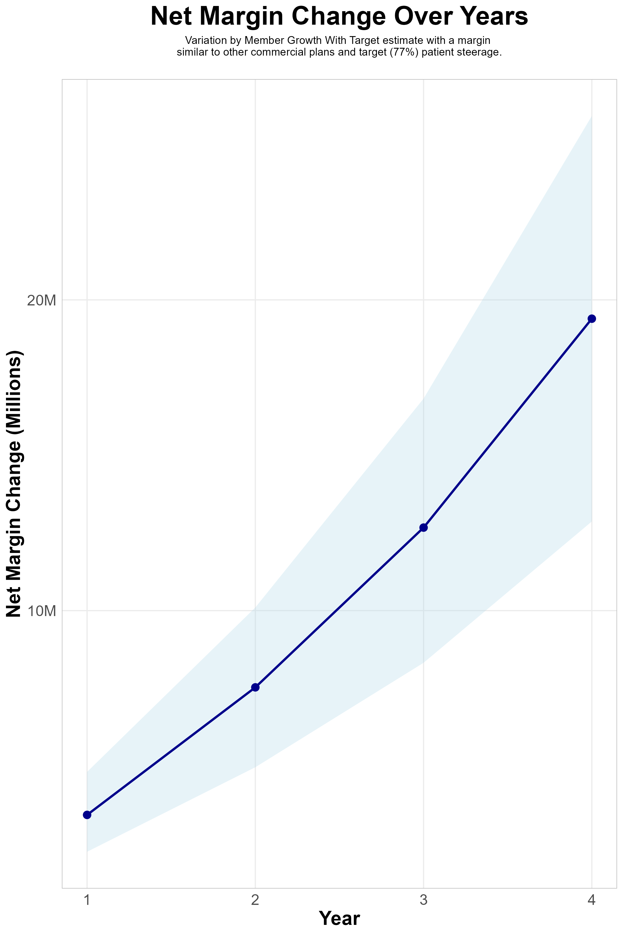
EPO 4-YEAR PROJECTIONS
Target Member Growth | Target Member Growth | Target Member Growth | Target Member Growth | Target Member Growth
Metric | Year 1 | Year 2 | Year 3 | Year 4
Number of Members | 1,900 | 3,900 | 6,500 | 9,900
Incremental Margin | 3,733.8K | 7,664.2K | 12,773.7K | 19,455.3K
Network Access Fee | 22.8K | 46.8K | 78.0K | 118.8K
Implementation Fee (One-Time) | -150.0K | 0.0K | 0.0K | 0.0K
Sales and Marketing Costs | -180.0K | -180.0K | -180.0K | -180.0K
Net Margin Change | 3,426.6K | 7,531.0K | 12,671.7K | 19,394.1K
High Member Growth | High Member Growth | High Member Growth | High Member Growth | High Member Growth
Metric | Year 1 | Year 2 | Year 3 | Year 4
Number of Members | 2,600 | 5,200 | 8,600 | 13,200
Incremental Margin | 5,109.5K | 10,218.9K | 16,900.6K | 25,940.4K
Network Access Fee | 31.2K | 62.4K | 103.2K | 158.4K
Implementation Fee (One-Time) | -150.0K | 0.0K | 0.0K | 0.0K
Sales and Marketing Costs | -180.0K | -180.0K | -180.0K | -180.0K
Net Margin Change | 4,810.7K | 10,101.3K | 16,823.8K | 25,918.8K
Low Member Growth | Low Member Growth | Low Member Growth | Low Member Growth | Low Member Growth
Metric | Year 1 | Year 2 | Year 3 | Year 4
Number of Members | 1,300 | 2,600 | 4,300 | 6,600
Incremental Margin | 2,554.7K | 5,109.5K | 8,450.3K | 12,970.2K
Network Access Fee | 15.6K | 31.2K | 51.6K | 79.2K
Implementation Fee (One-Time) | -150.0K | 0.0K | 0.0K | 0.0K
Sales and Marketing Costs | -180.0K | -180.0K | -180.0K | -180.0K
Net Margin Change | 2,240.3K | 4,960.7K | 8,321.9K | 12,869.4K

Slide 14
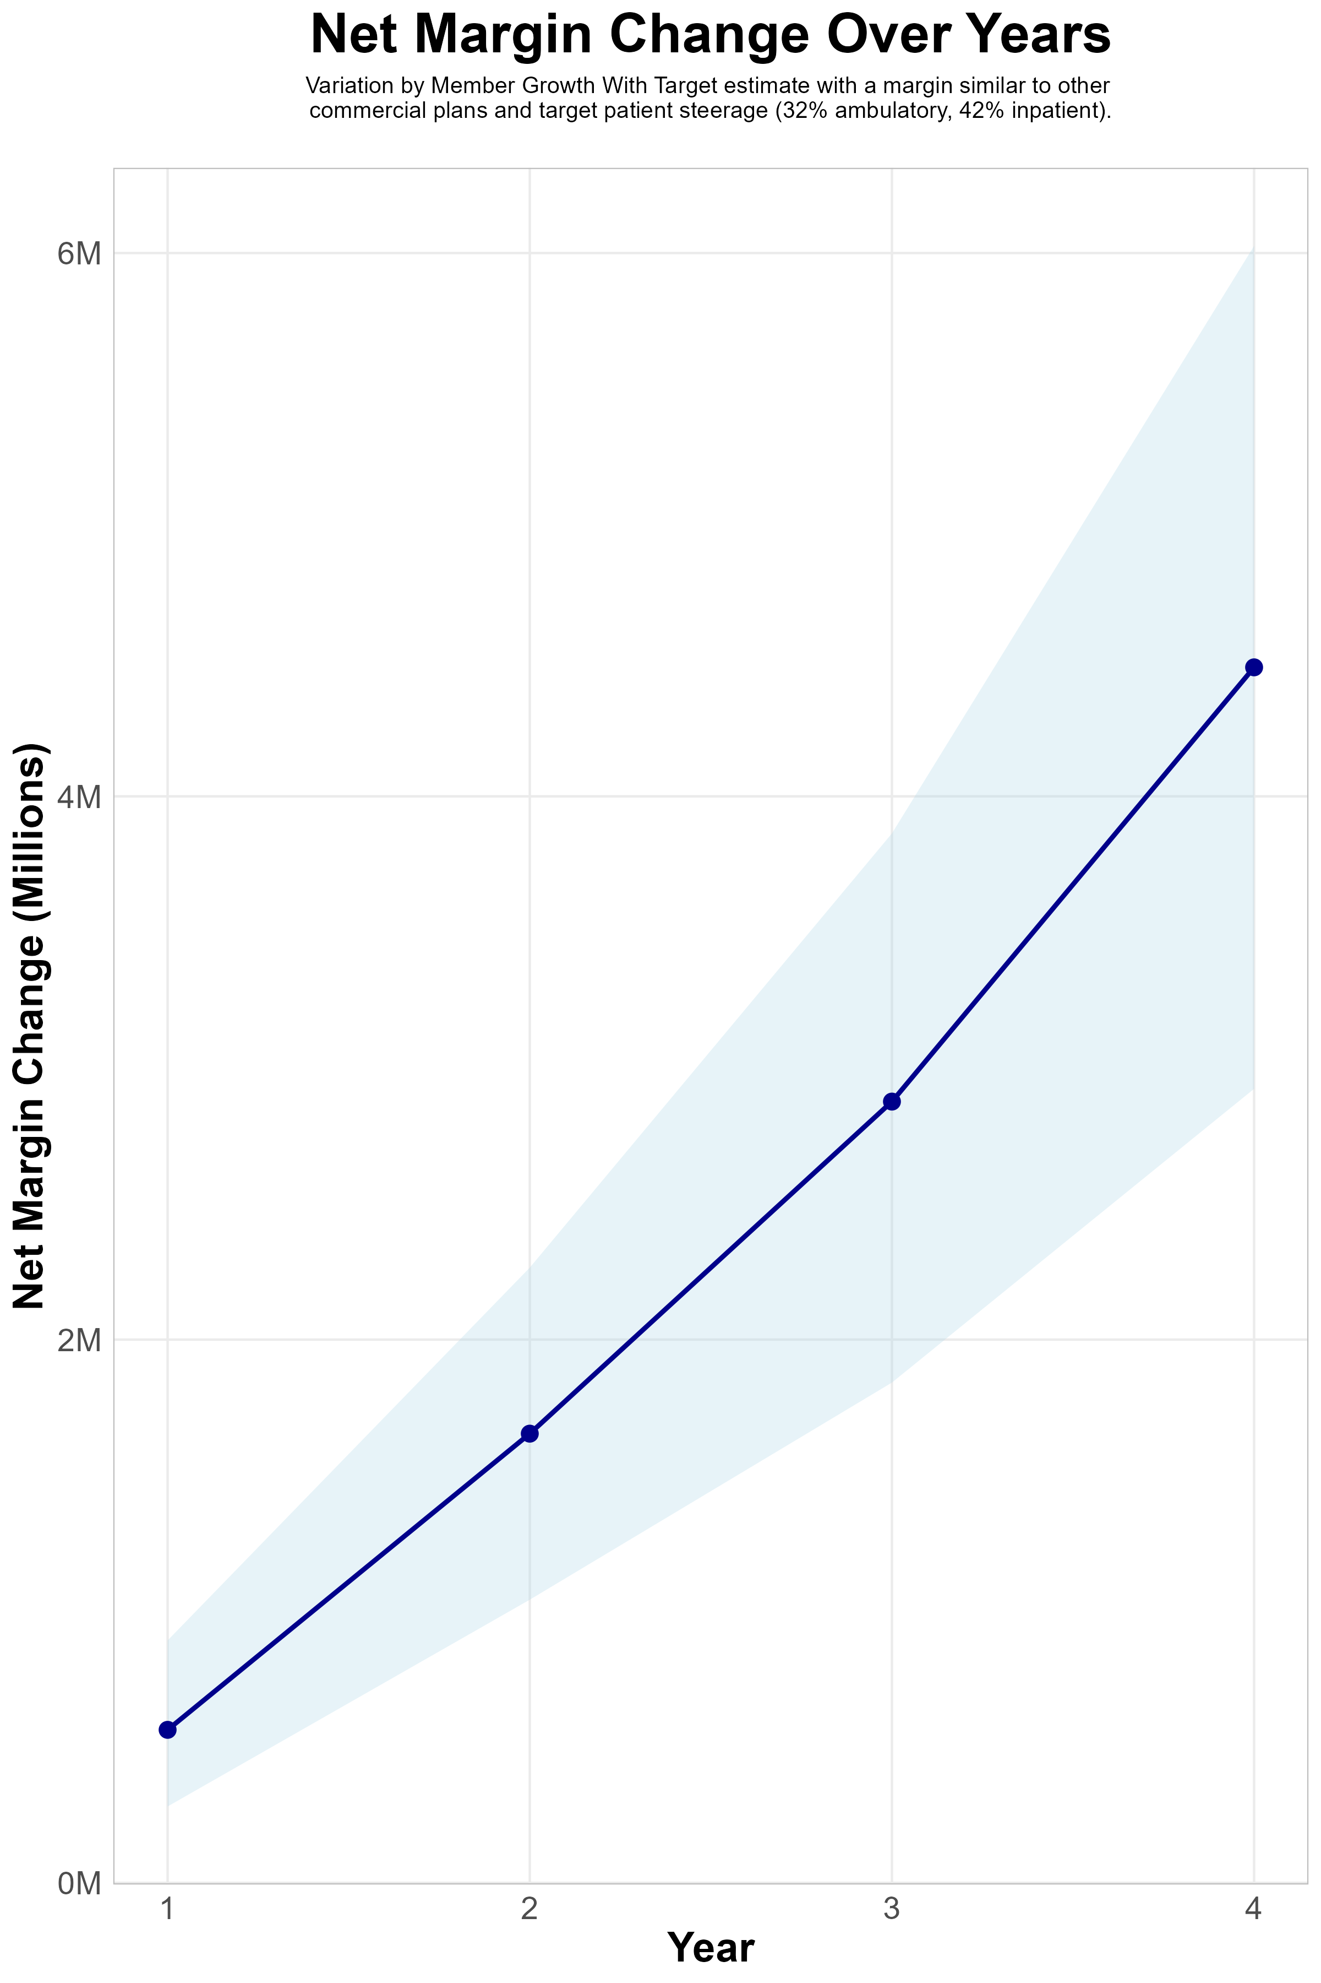
PPO 4-YEAR PROJECTIONS
Target Member Growth | Target Member Growth | Target Member Growth | Target Member Growth | Target Member Growth
Metric | Year 1 | Year 2 | Year 3 | Year 4
Number of Members | 1,900 | 3,900 | 6,500 | 9,900
Incremental Margin | 870.6K | 1,786.9K | 2,978.2K | 4,536.1K
Network Access Fee | 22.8K | 46.8K | 78.0K | 118.8K
Implementation Fee (One-Time) | -150.0K | 0.0K | 0.0K | 0.0K
Sales and Marketing Costs | -180.0K | -180.0K | -180.0K | -180.0K
Net Margin Change | 563.4K | 1,653.7K | 2,876.2K | 4,474.9K
High Member Growth | High Member Growth | High Member Growth | High Member Growth | High Member Growth
Metric | Year 1 | Year 2 | Year 3 | Year 4
Number of Members | 2,600 | 5,200 | 8,600 | 13,200
Incremental Margin | 1,191.3K | 2,382.6K | 3,940.4K | 6,048.1K
Network Access Fee | 31.2K | 62.4K | 103.2K | 158.4K
Implementation Fee (One-Time) | -150.0K | 0.0K | 0.0K | 0.0K
Sales and Marketing Costs | -180.0K | -180.0K | -180.0K | -180.0K
Net Margin Change | 892.5K | 2,265.0K | 3,863.6K | 6,026.5K
Low Member Growth | Low Member Growth | Low Member Growth | Low Member Growth | Low Member Growth
Metric | Year 1 | Year 2 | Year 3 | Year 4
Number of Members | 1,300 | 2,600 | 4,300 | 6,600
Incremental Margin | 595.6K | 1,191.3K | 1,970.2K | 3,024.1K
Network Access Fee | 15.6K | 31.2K | 51.6K | 79.2K
Implementation Fee (One-Time) | -150.0K | 0.0K | 0.0K | 0.0K
Sales and Marketing Costs | -180.0K | -180.0K | -180.0K | -180.0K
Net Margin Change | 281.2K | 1,042.5K | 1,841.8K | 2,923.3K

Slide 15
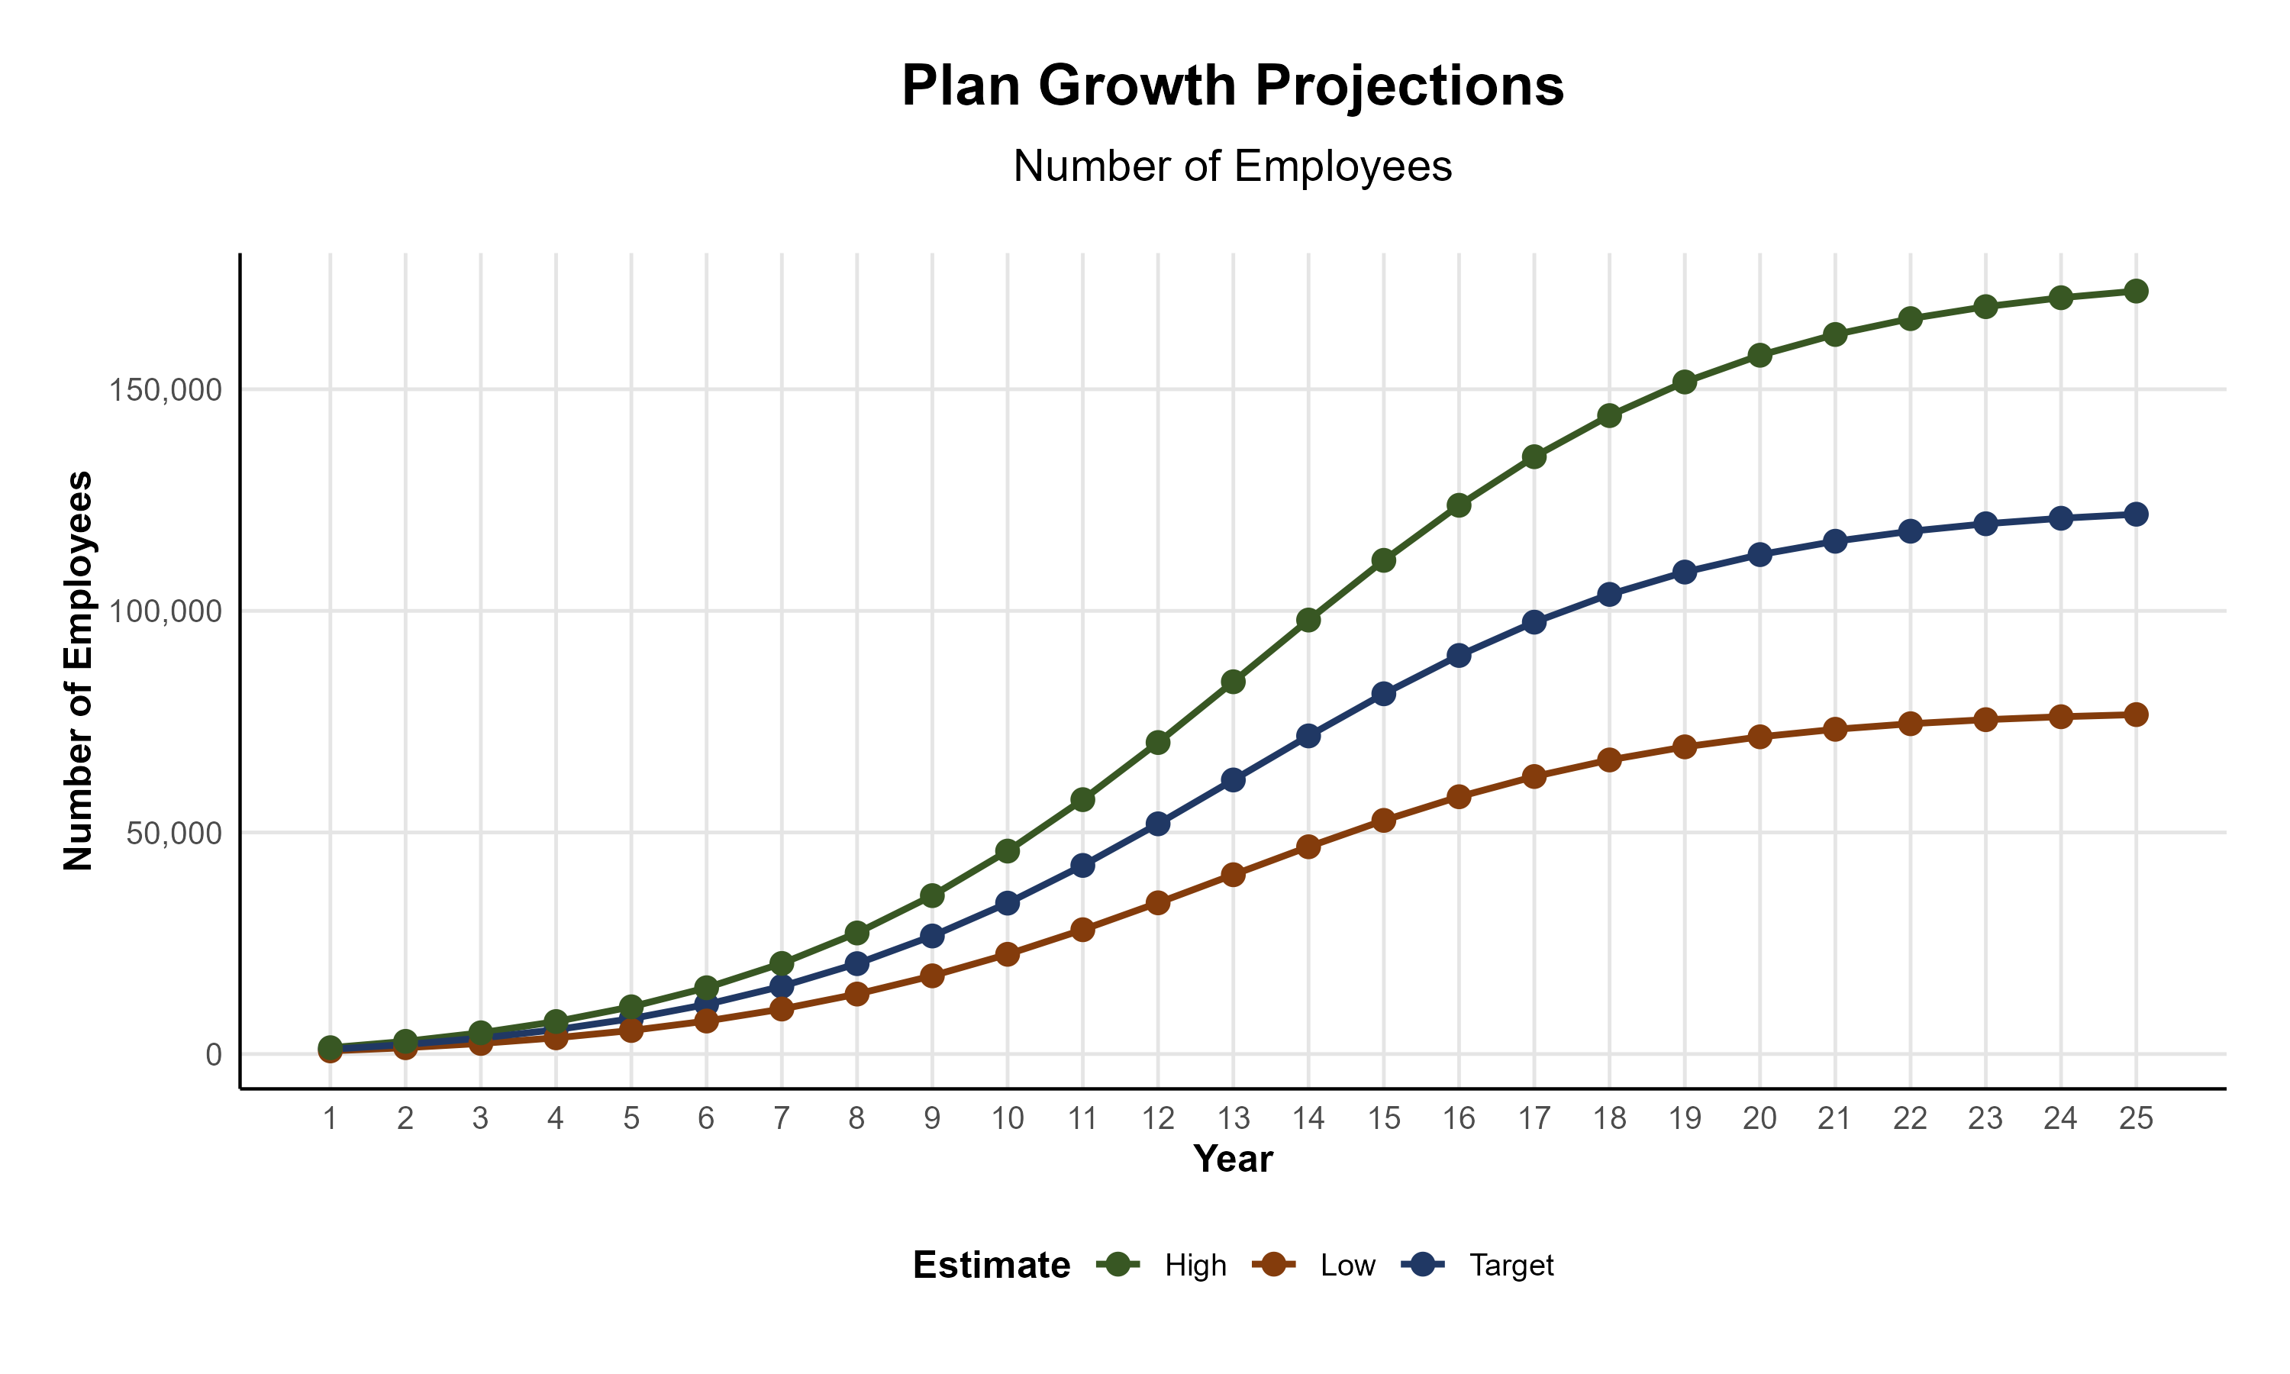
Potential Growth Paths
Self Funded
538K
Insured
935K
PLAN GROWTH POTENTIAL
Working Age
1,230K
Population
2,106K
Estimates include Hunterdon, Warren, Bucks, Carbon, Lehigh, Luzerne, Northampton, and Schuylkill Counties
PPO growth will likely be higher, but KBA expects that long-term growth is more inhibited by the plan being a non-national network more than being an EPO plan. KBA expect 15% of the market to be open to a local (non-national) network.

Slide 16

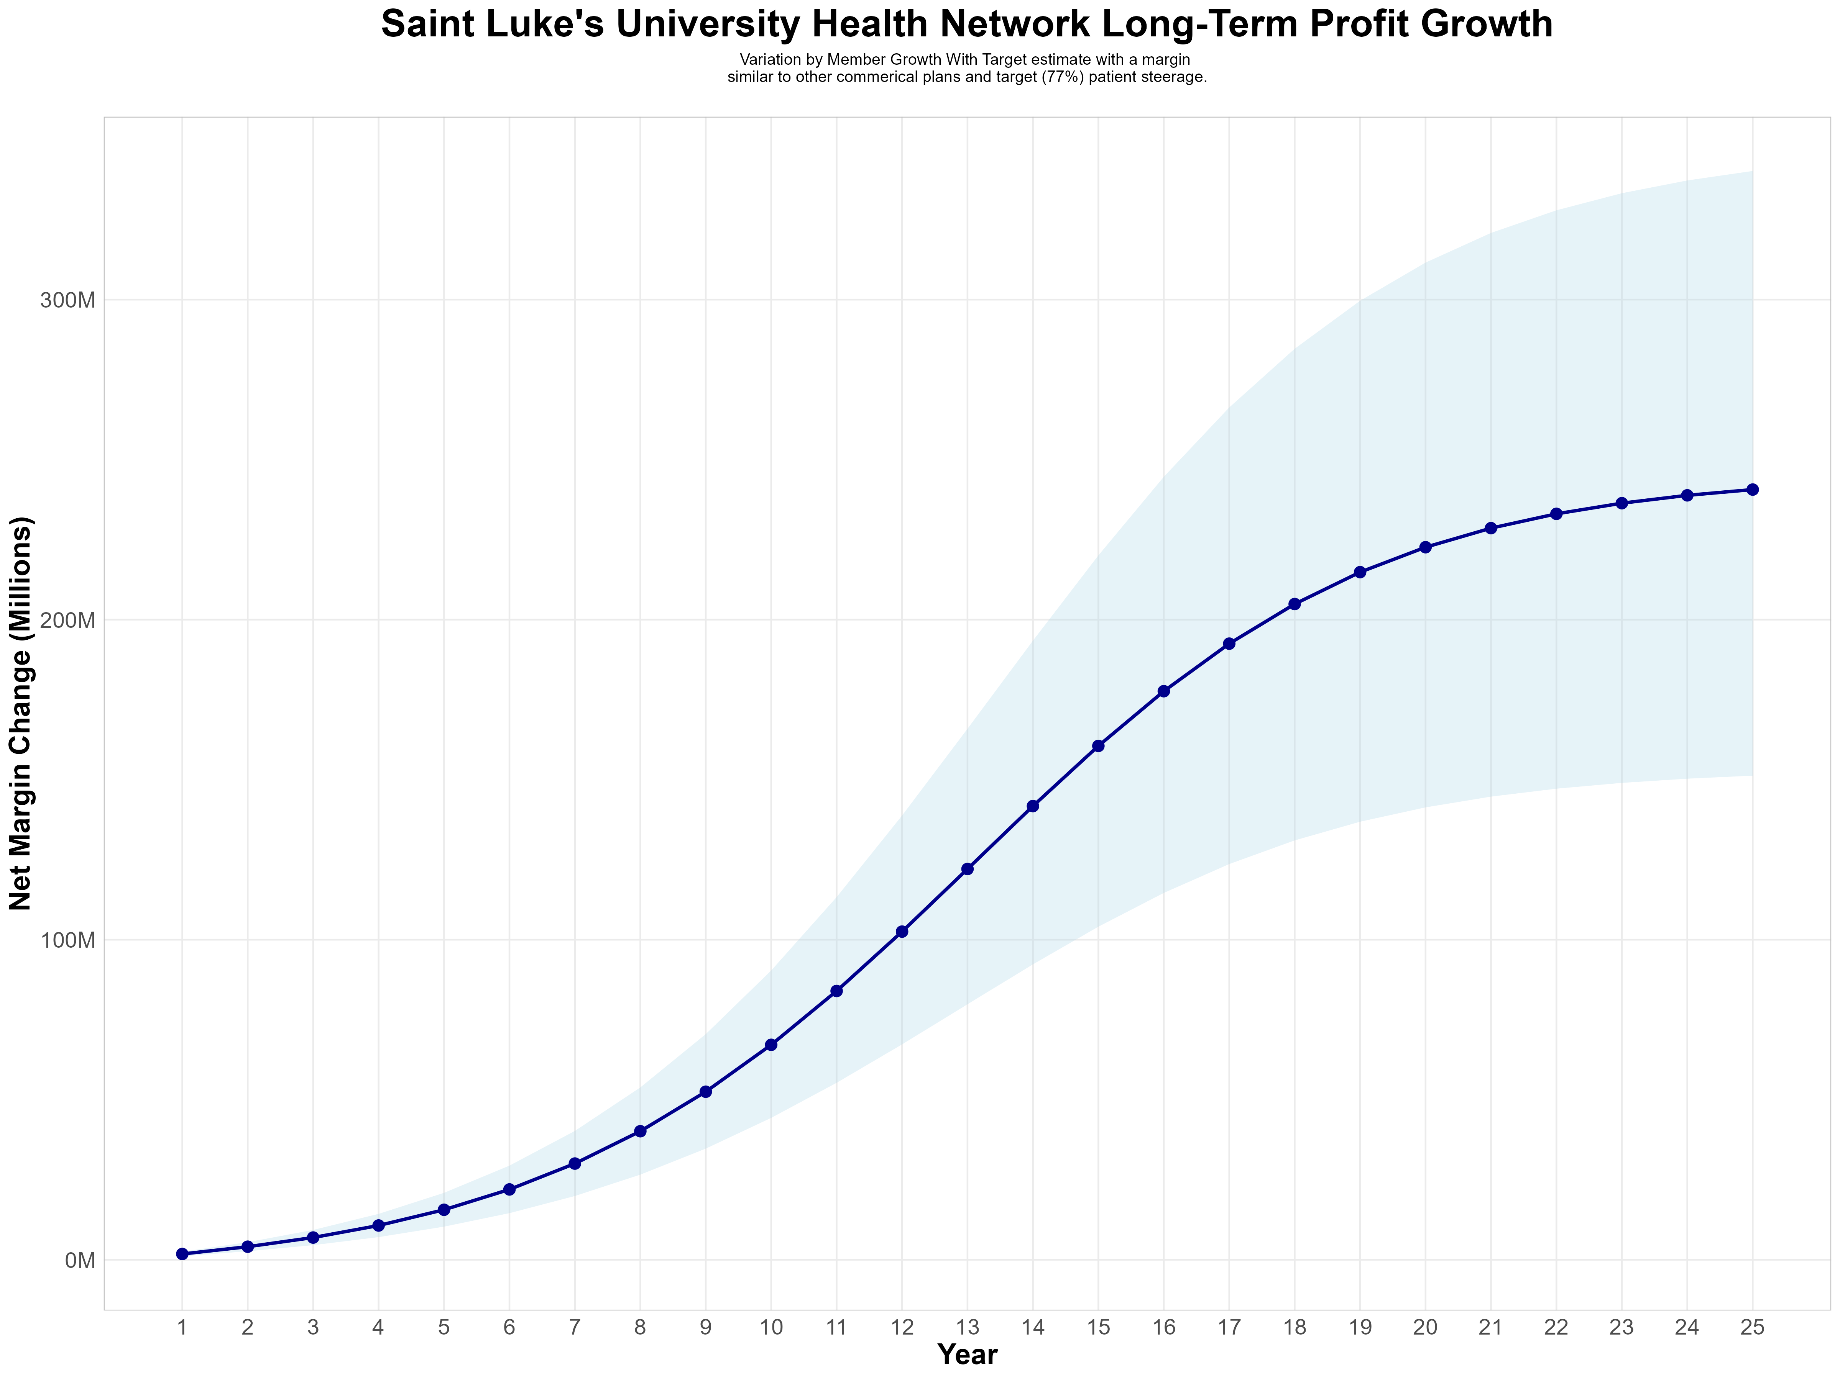
Long-Term EPO Profit: $223M
Early Stage
Graining Name Recognition, Early Growth
New Revenue:
New Profit:
$63.33M
$16.41M
Growth Stage
Strong Reputation, Strong Growth
New Revenue:
New Profit:
$433.64M
$113.52M
Mature Stage
High Profitability, Market Saturation
New Revenue:
New Profit:
$853.45M
$223.6M

Slide 17

Long-Term PPO Profit: $53M
Early Stage
Graining Name Recognition, Early Growth
Early Stage
Graining Name Recognition, Early Growth
New Revenue:
New Revenue:
New Profit:
$14.47M
$3.75M
$14.47M
$3.75M
Growth Stage
Strong Reputation, Strong Growth
New Revenue:
New Profit:
$99.06M
$26.86M
Mature Stage
High Profitability, Market Saturation
New Revenue:
New Profit:
$194.97M
$53.04M

